Slide 1
India Shield AI – Real-Time Disaster Intelligence System
MENTOR: Dr N. Shirisha, Assoc.Prof.
BATCH NO: 16
TEAM MEMBERS:
2320030077 – A. Abhiram
2320030110 – P. Prajwal
2320030459 – N. Nandini

Slide 2
Table of contents
ABSTRACT
INTRODUCTION
EXISTING SYSTEM
PROPOSED SYSTEM
OBJECTIVES
LITERATURE SURVEY
SOFTWARE REQUIREMENTS
HARDWARE REQUIREMENTS
FUNCTIONAL REQUIREMENTS
NON – FUNCTIONAL REQUIREMENTS
SYSTEM ARCHITECTURE
UML DIAGRAM
ACTIVITY DIAGRAM
MODULE DESIGN

Slide 3
Review – 2 comments addressed
Modules of the project are clearly defined
Tools and requirements are finalized
Real-time pipeline implemented
ML model integrated for prediction

Slide 4
ABSTRACT
India Shield AI is a real-time disaster intelligence system designed to detect, analyze, and predict disasters using advanced data processing and machine learning techniques. In traditional disaster management systems, there is a significant delay in detecting and responding to disasters due to lack of real-time data integration and predictive capabilities, and these systems are often unable to handle large volumes of data from multiple sources and fail to provide timely insights for decision-making. Our project addresses these limitations by integrating real-time data streams from various sources such as social media (Twitter), weather APIs, news feeds, and IoT sensors, and by using Apache Kafka and Apache Spark to process high-velocity streaming data efficiently. Machine learning models are applied to predict disaster severity based on multiple features such as location, environmental conditions, and textual analysis. The system continuously monitors incoming data and updates predictions without interrupting the existing workflow, while the processed data is stored in distributed storage (HDFS) and visualized through an interactive dashboard built using React, enabling users to track disasters in real-time. Automated alert mechanisms such as notifications and messages help authorities respond quickly. Our main goal is to develop a scalable, reliable, and efficient disaster management system that enhances real-time decision-making and improves emergency response through intelligent automation and predictive analytics.

Slide 5
Introduction
India Shield AI – India Shield AI is a real-time disaster intelligence system that aims to detect, analyze, and predict disasters using big data and machine learning technologies in a reliable and efficient manner.
Data Pipeline – It automates the data processing workflow by collecting data from multiple sources and transforming it into meaningful insights that can be analyzed for disaster detection and prediction.
India Shield AI is used for:
Real-time disaster detection from multiple data sources
Processing high-volume streaming data using Kafka and Spark
Predicting disaster severity using machine learning models
Visualizing disasters on interactive dashboards
Sending automated alerts to authorities
Monitoring system performance and data flow
Supporting faster decision-making in emergency situations

Slide 6
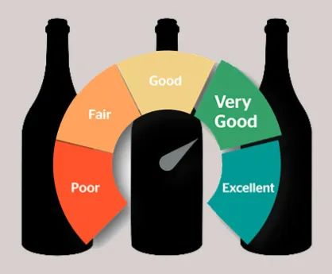
Existing system
Considering the Traditional Disaster Management Systems
▪ In traditional disaster management, the process relies on manual reporting, news updates, and limited monitoring systems, which leads to delays in detecting disasters and responding effectively.
▪ There is no proper integration of multiple data sources such as social media, weather data, and sensor inputs, making it difficult to analyze real-time situations accurately.
▪ Later on, to overcome these limitations, some systems started using basic data analysis and monitoring tools, but they still lack real-time processing and predictive capabilities for disaster severity.

Slide 7
Proposed system
Our goal is to build a scalable and efficient real-time disaster intelligence system that enables fast detection, analysis, and prediction of disasters using big data and machine learning technologies. The main purpose is to continuously collect and process data from multiple sources such as social media, weather APIs, news feeds, and IoT sensors to provide real-time insights. We are using Apache Kafka and Apache Spark to automate the data pipeline and handle high-volume streaming data efficiently. Machine learning models are applied to predict the severity of disasters based on various factors such as location, environmental conditions, and textual analysis. The processed data is stored in distributed systems like HDFS and visualized through an interactive dashboard for better monitoring. This system improves response time, reduces manual effort, and supports better decision-making. The proposed solution ensures high scalability, reliability, and accuracy, and helps authorities take quick actions during emergency situations.

Slide 8
Objectives
The objectives of the proposed system include the following:-
To detect disasters in real-time from multiple data sources
To process and analyze large-scale streaming data efficiently
To predict disaster severity using machine learning models
To provide accurate and timely alerts to authorities
To visualize disaster events through an interactive dashboard
To improve response time in emergency situations
To ensure system scalability, reliability, and performance

Slide 9
Software requirements
Below are the software requirements for application development:
Python IDE (VS Code)
Apache Kafka
Apache Spark
Hadoop HDFS
React + TypeScript
Scikit-learn
Docker

Slide 10
Hardware requirements
Hardware requirements for application development are as follows:
CPU – Intel i5 or higher
RAM – 8 GB or higher
Storage – 20 GB or higher
OS – Windows 10 / Linux

Slide 11
FUNCTIONAL requirements
System should be able to collect real-time data from multiple sources
System must be able to process streaming data using Kafka and Spark
System should detect disaster events from incoming data
Model should be able to predict disaster severity accurately
System should display results on an interactive dashboard
System should send alerts and notifications to users

Slide 12
Non - functional requirements
Reliability: The system should process real-time data accurately and handle failures without data loss.
Security: The system should ensure authorized access and protect sensitive disaster data.
Scalability: The system should be able to handle large volumes of streaming data (10K+ events/sec).
Performance: The system should provide fast response time with low latency for real-time alerts and dashboard updates.

Slide 13
Literature survey
S. No | Name of the research paper | Author name | Technologies used | Advantages / Disadvantages
1 | Crisis Event Detection using Social Media, 2016 | Carlos Castillo et al. | NLP, Social Media Mining | Advantage: Real-time detection using tweets. Disadvantage: Noisy and unverified data
2 | Real-Time Flood Detection using IoT and ML, 2019 | S. N. Shah et al. | IoT Sensors, Machine Learning | Advantage: Early flood warnings. Disadvantage: Requires sensor infrastructure
3 | Big Data Stream Processing with Apache Kafka and Spark, 2018 | Tyler Akidau et al. | Kafka, Spark Streaming | Advantage: Handles large-scale streaming data. Disadvantage: Complex system setup

Slide 14
Literature survey
S. No | Name of the research paper | Author name | Technologies used | Advantages / Disadvantages
1 | Crisis Event Detection using Social Media, 2016 | Carlos Castillo et al. | NLP, Social Media Mining | Advantage: Real-time detection using tweets. Disadvantage: Noisy and unverified data
2 | Real-Time Flood Detection using IoT and ML, 2019 | S. N. Shah et al. | IoT Sensors, Machine Learning | Advantage: Early flood warnings. Disadvantage: Requires sensor infrastructure
3 | Big Data Stream Processing with Apache Kafka and Spark, 2018 | Tyler Akidau et al. | Kafka, Spark Streaming | Advantage: Handles large-scale streaming data. Disadvantage: Complex system setup

Slide 15
Literature survey
S. No | Name of the research paper | Author name | Technologies used | Advantages / Disadvantages
4 | Disaster Prediction using Machine Learning Techniques, 2020 | R. K. Singh et al. | Random Forest, SVM | Advantage: Accurate prediction of disaster severity. Disadvantage: Needs large datasets
5 | A Survey on Disaster Management using Big Data Analytics, 2021 | A. Sharma et al. | Big Data, Cloud Computing | Advantage: Integrates multiple data sources. Disadvantage: High computational cost
6 | Real-Time Event Detection System using Streaming Data, 2019 | J. Kreps et al. | Kafka, Distributed Systems | Advantage: Low latency processing. Disadvantage: Requires proper configuration

Slide 16
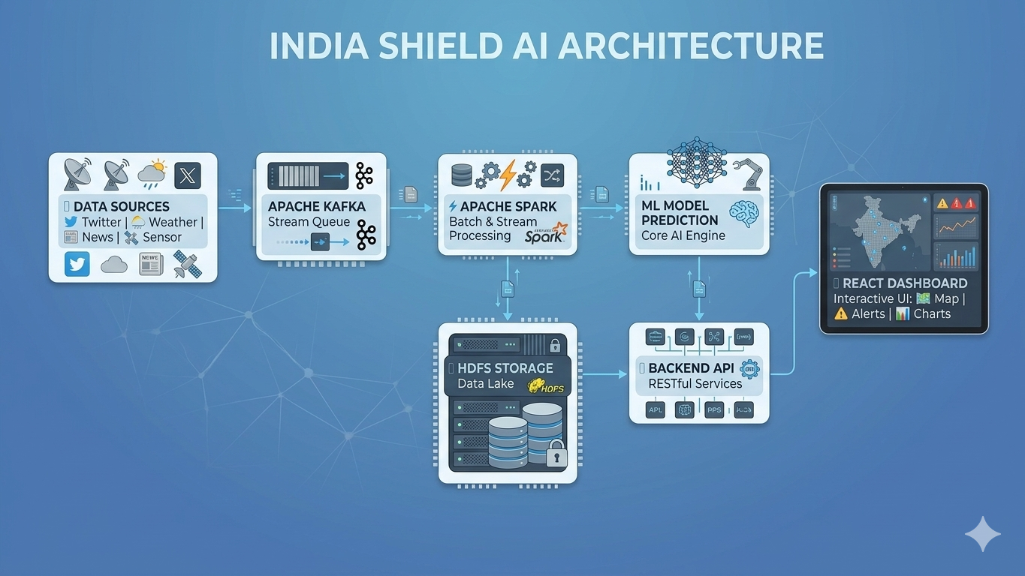
System Architecture
The system processes real-time disaster data by integrating multiple sources such as social media, weather APIs, news feeds, and IoT sensors through an automated data pipeline. Data is streamed using Kafka, processed with Spark, and analyzed using machine learning models to predict disaster severity and store results in HDFS. The output is delivered to a React dashboard for real-time visualization and alerts, ensuring scalability, reliability, and fast response.

Slide 17
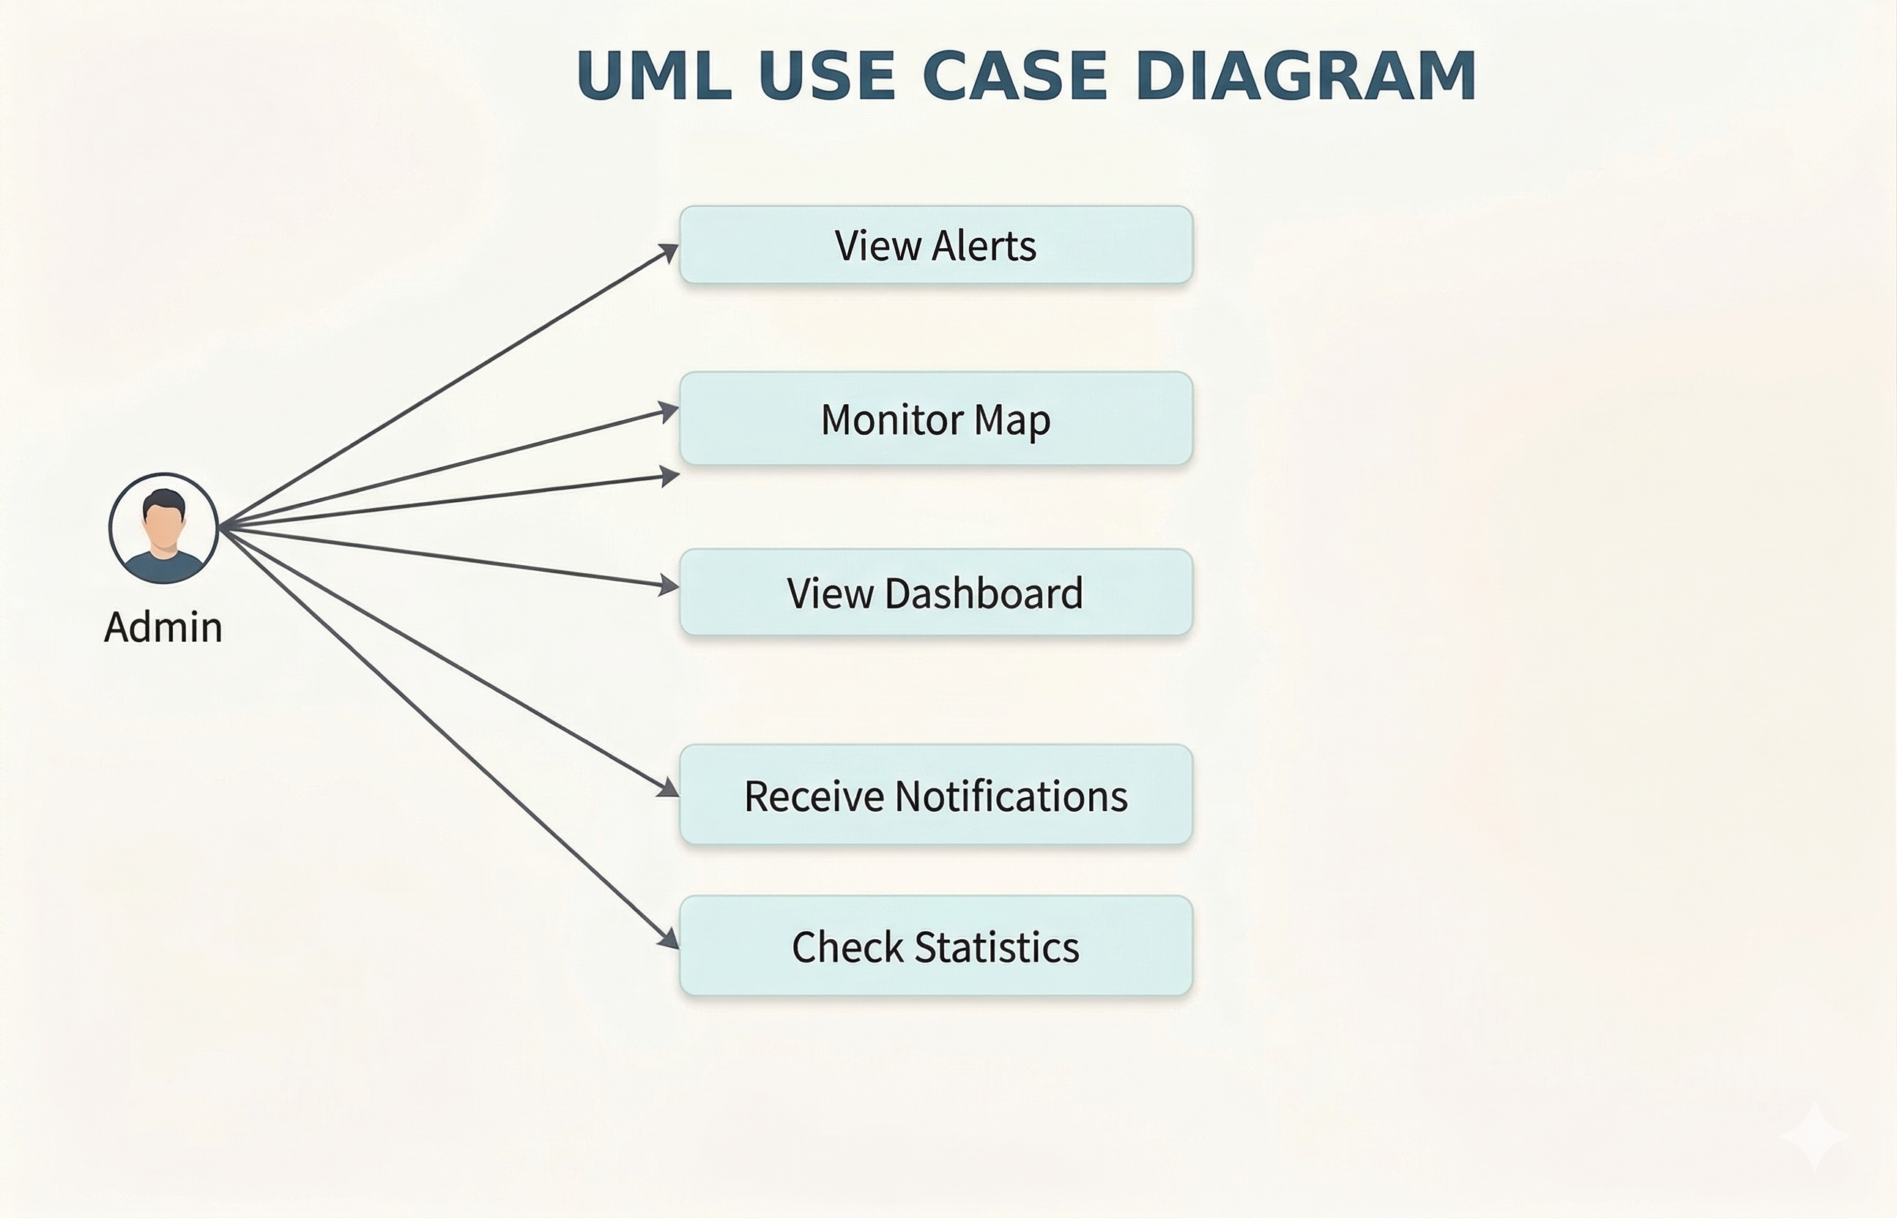
Uml diagram

Slide 18
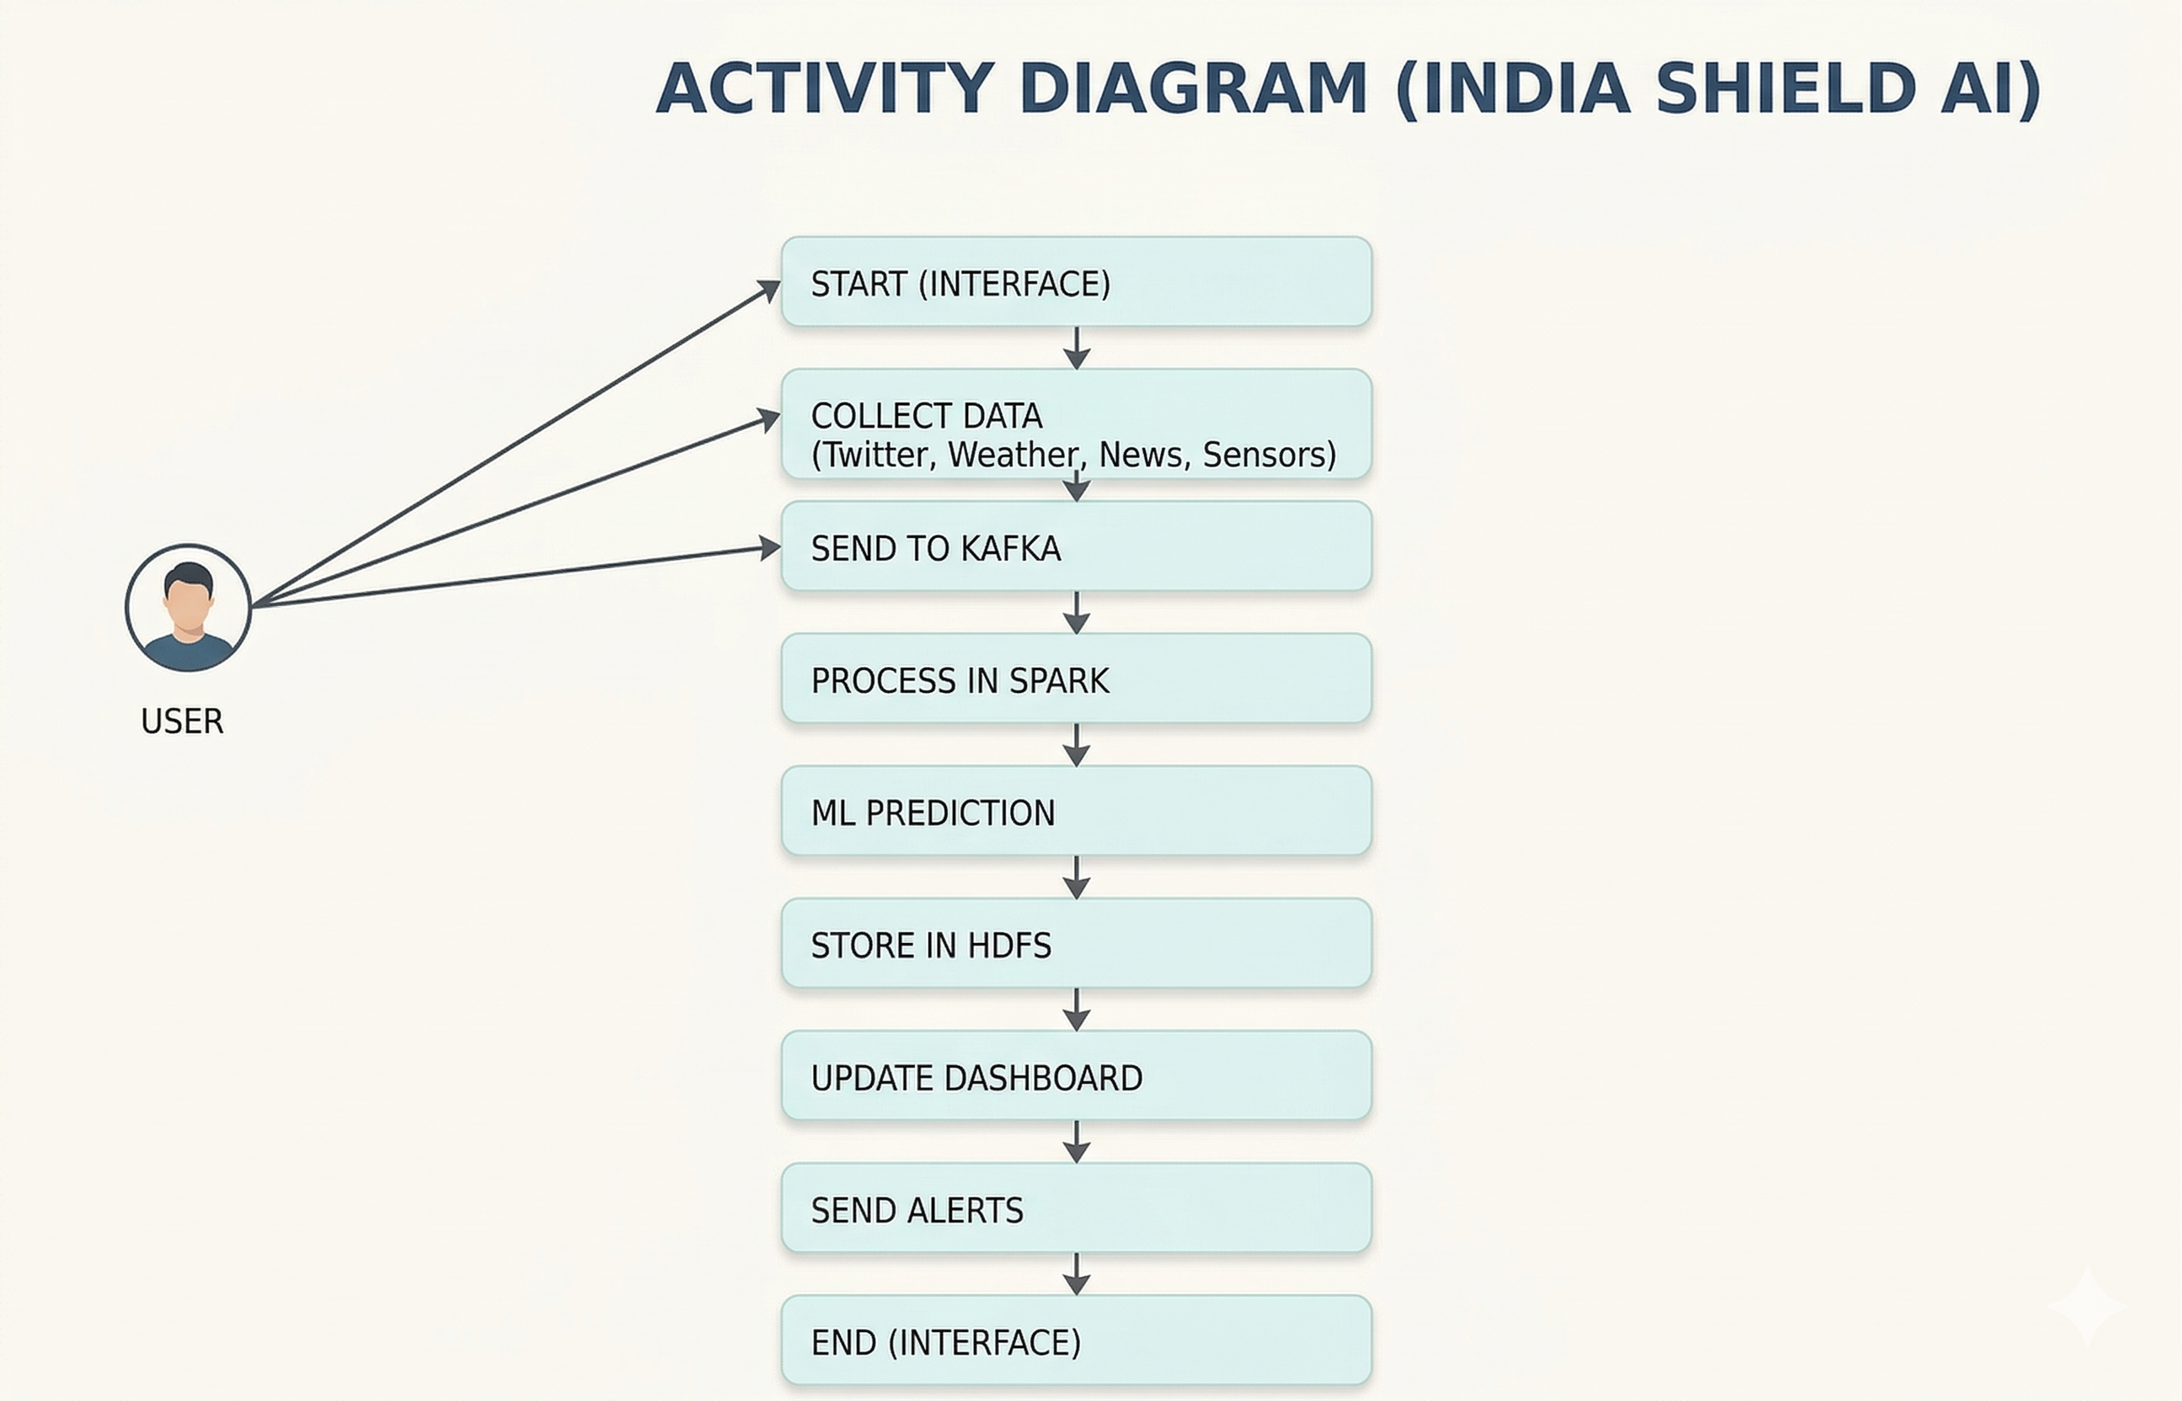
Activity diagram

Slide 19
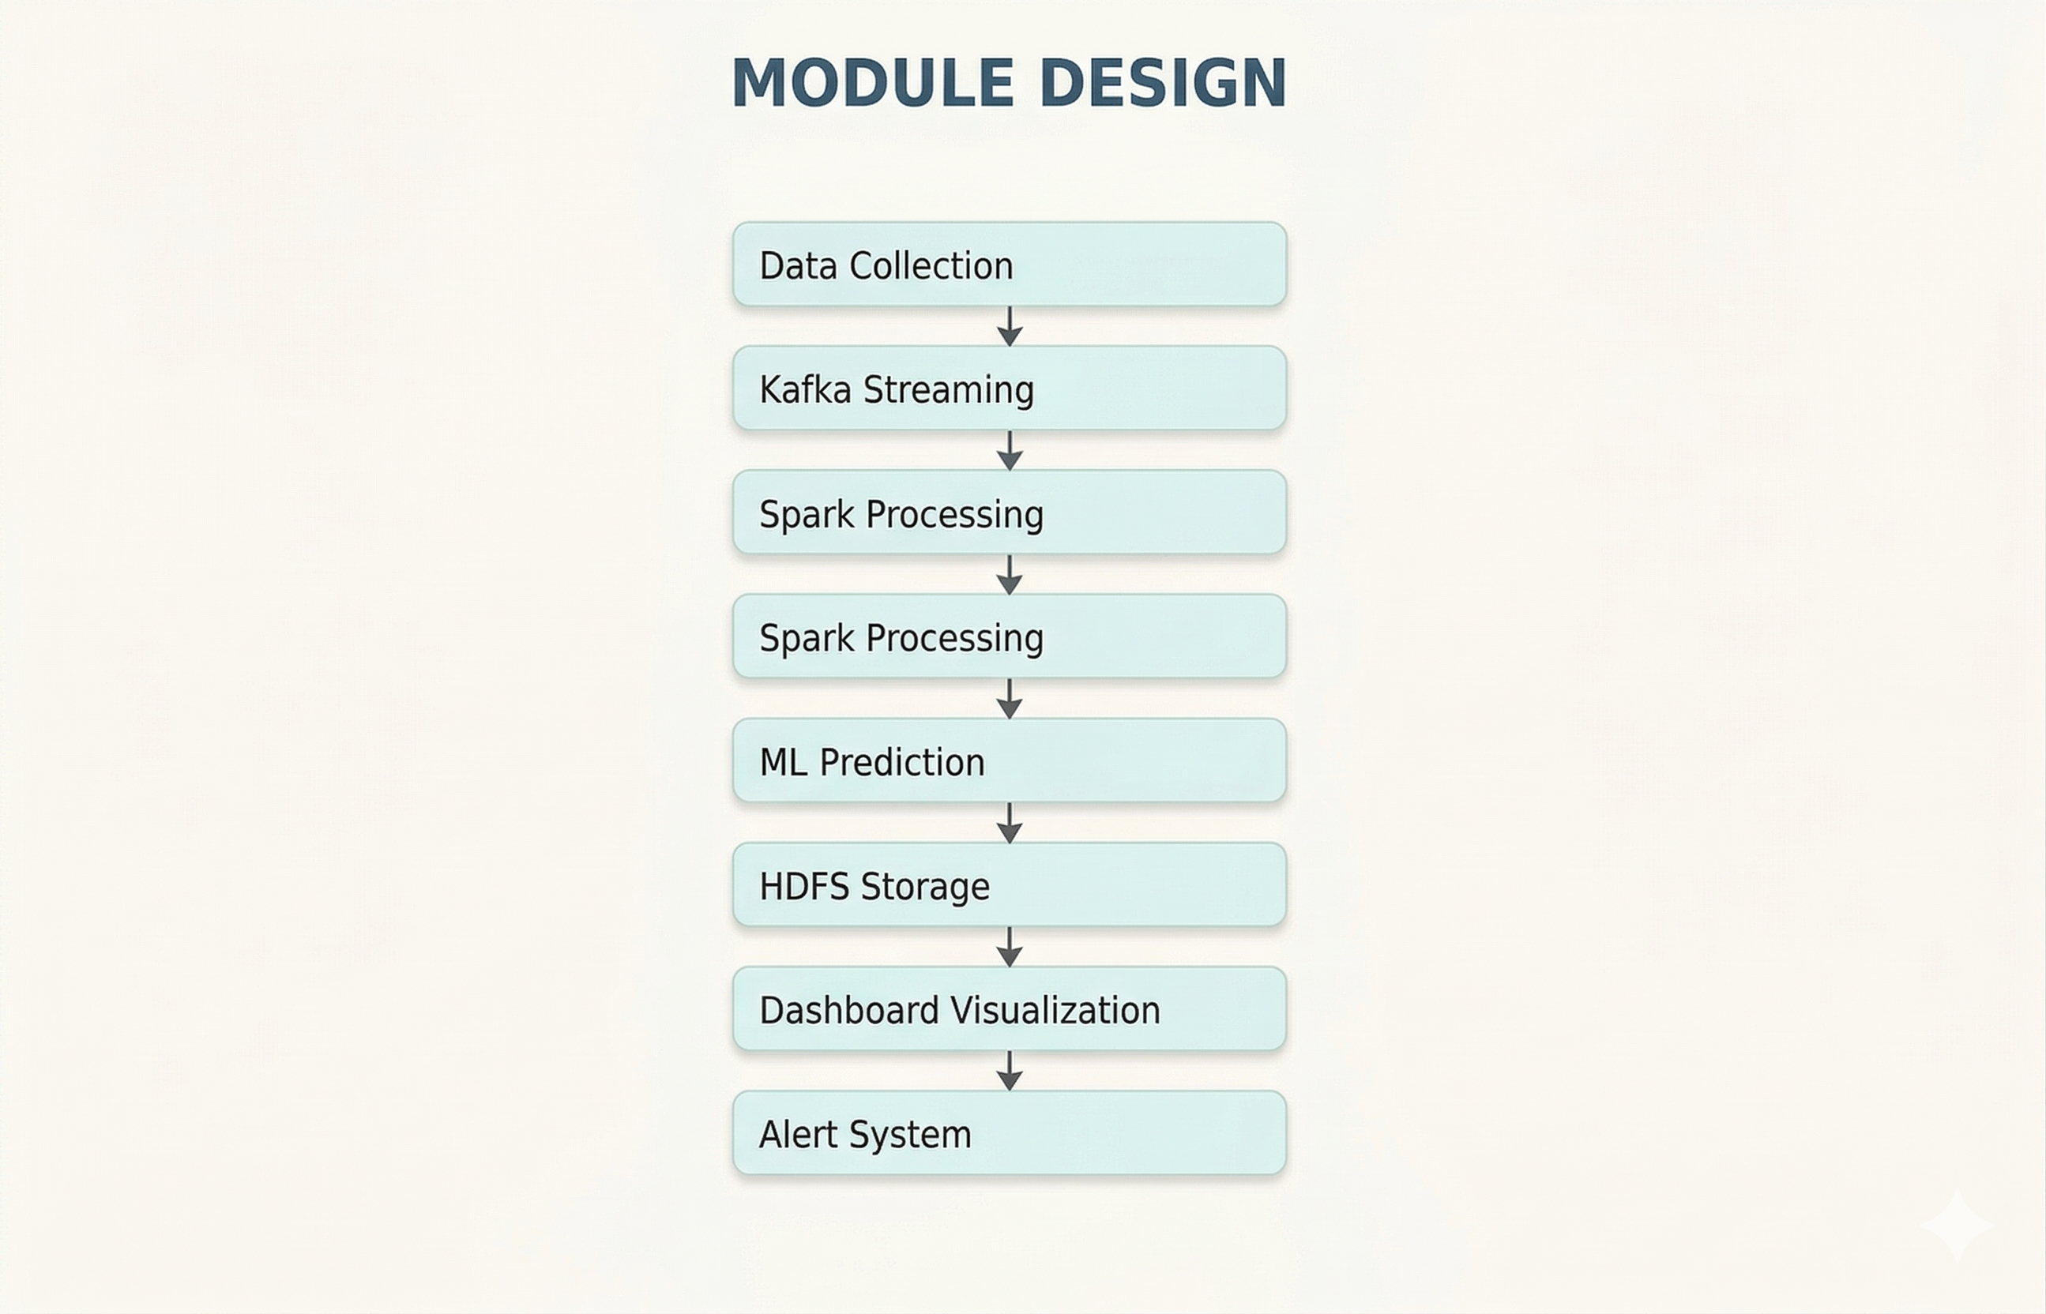
Module design

Slide 20


